Slide 1
FDLP Forecast Study
Discovering the Path to Achieve Our Shared Vision
Mary Alice Baish
Superintendent of Documents
Northwest Government Information Network
November 26, 2012

Slide 2
Principles of Government Information
The public has the right of access to government information
Government has the obligation to disseminate and provide broad public access to its information
Government has an obligation to guarantee the authenticity and integrity of its information
Government has an obligation to preserve its information
Government information created or compiled by government employees or at government expense should remain in the public domain

Slide 3
FDLP Vision and Mission
VISION
The Federal Depository Library Program will provide Government information when and where it is needed in order to create an informed citizenry and an improved quality of life.
MISSION
The mission of the Federal Depository Library Program is to provide for no-fee ready and permanent public access to Federal Government information, now and for future generations.

Slide 4
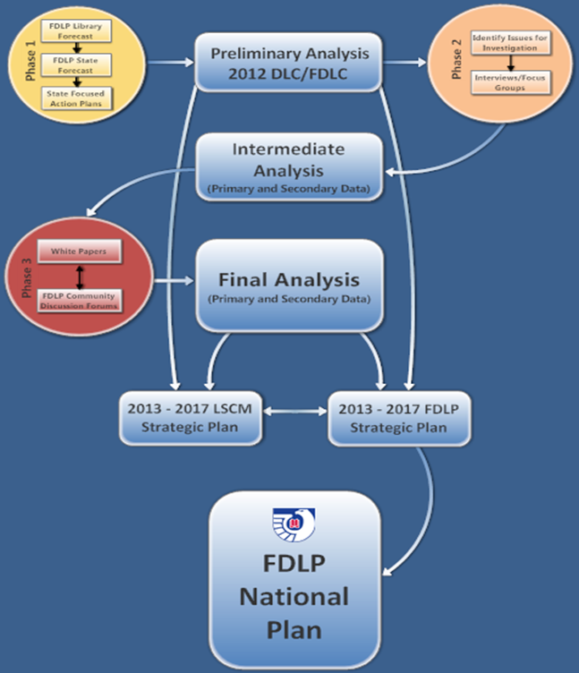
The FDLP Forecast Study Process

Slide 5
From the State Forecasts
Question 18:
What would an ideal FDLP look like that met all of your current and anticipated needs for Federal Government information?
Question 20:
Is there anything else that you would like to tell us about the current and future vision of the FDLP?

Slide 6
State Forecasts: Frequent Issues
Program Governance
Preservation, Digitization, Access, and Harvesting
Training and Education
Cataloging and Bibliographic Control
Item Selection and Distribution

Slide 7
Program Governance
More flexibility
“Different needs and pressures: one size doesn’t fit all”
“Combining collections: regional areas that cooperate to develop 100%”
“Consortia options – flexibility to work within states and across state borders for services, preservation, bibliographic control, and more”

Slide 8
Program Governance
(Continued)
Liberal retention, withdrawal, and disposal
“Adapt current and anticipated technologies and workflows”
“Minimize physical footprint”
“Streamline/simplify selection and discard”
“Flexible protocols for substitution of digital surrogates”

Slide 9
SFAP: WA/AK depositories will:
Initiative 1: Work collaboratively to establish a new regional depository model based upon the present Oregon model. The new Washington/Alaska regional depository model will hereafter be referred to as the Washington/Alaska model (WAM).
Initiative 2: Continue to work collaboratively, to the extent possible while completing the move to the WAM, on the existing five year plans for Federal depository library service.
Initiative 3: After the WAM has been implemented, all Federal depository libraries in region will work collaboratively to revise five year plans for Washington and Alaska.

Slide 10
Moving Toward Strategic Plans and the FDLP of the Future
In Process
Doable
Possible
Requires legal change

Slide 11
Questions?
Mary Alice Baish, mabaish@gpo.gov

